Slide 1

Comparative and superlative

Slide 2
As … AS
We use as + adjective/adverb + as to make comparisons when the things we are comparing are equal in some way:
The world’s biggest bull is as big as a small elephant.
The weather this summer is as bad as last year. It hasn’t stopped raining for weeks.
You have to unwrap it as carefully as you can. It’s quite fragile.

Slide 3
Not As … AS
We use not as … as to make comparisons between things which aren’t equal:
It’s not as heavy as I thought it would be, actually.
Rory hasn’t grown as tall as Tommy yet.
She’s not singing as loudly as she can.
They didn’t play as well as they usually do.
We can also use not so … as. Not so … as is less common than not as … as:
The cycling was good but not so hard as the cross country skiing we did.

Slide 4
We can modify not as … as by using not quite as or not nearly as:
The second race was not quite as easy as the first one. (The second race was easy but the first one was easier.)
These new shoes are not nearly as comfortable as my old ones. (My old shoes are a lot more comfortable than these new shoes.)

Slide 5
As … as + possibility
We often use expressions of possibility or ability after as … as:
Can you come as soon as possible?
Go to as many places as you can.
We got here as fast as we could.

Slide 6
Forming regular comparatives and superlatives
We use comparatives to compare two things or two people. (e.g She is taller than her husband.)
Superlatives are used, however, to show the difference between more than two things or more than two people. (e.g Paris is the biggest city in France)
To form comparatives and superlatives you need to know the number of the syllables in the adjective.

Slide 7
Rules to form comparatives and superlatives:
One syllable adjective ending in a silent 'e' — nice, add –r for comparative and –st for superlative.
nice → nicer / nicest
large → larger / largest

Slide 8
One syllable adjective ending in one vowel and one consonant, double the last consonant and add –er for comparative and –est for superlative.
wet → wetter / wettest
big → bigger / biggest
hot → hotter / hottest
thin → thinner / thinnest

Slide 9
One syllable adjective ending in more than one consonant or more than a vowel, add –er for comparative and –est for superlative.
clean → cleaner / cleanest
cold → colder / coldest
small → smaller / smallest
young → younger / youngest
tall → taller / tallest

Slide 10
A one or two syllable adjective ending in ‘y’, change the ‘y’ for an ‘i’ and add –er for comparative and –est for superlative.
dry → drier / driest
happy → happier / happiest
dirty → dirtier / dirtiest
pretty → prettier / prettiest
ugly → uglier / ugliest

Slide 11
Two syllable or more adjectives without 'y' at the end, we use
For comparative: more + adjective + than
For superlative: the most + adjective
expensive → more expensive / the most expensive
beautiful → more beautiful / the most beautiful
intelligent → more intelligent / the most intelligent
interesting → more interesting / the most interesting

Slide 12
Examples
The Nile River is longer and more famous than the Thames.
Egypt is much hotter than Sweden.
Everest is the highest mountain in the world.
This is one of the most exciting films I have ever seen.

Slide 13
Irregular comparatives and superlatives
Adjectives | Comparatives | Superlatives
bad | worse | worst
far (distance) | farther | farthest
far (extent) | further | furthest
good | better | best
little | less | least
many | more | most
much | more | most

Slide 14
Exercises
Adjective | Comparative | Superlative
simple
busy
tangled
heavy
dry
clean
fat

Slide 15
Fill in the comparison with as ... as.
John is (tall) ______________ Glen.
Janet is (beautiful) ______________ Jeniffer.
You are (crazy) ______________ my sister.
We can run (fast) ______________ they can.
My mom is (not / strict) ______________ your mum.
Your mobile phone is (not / trendy) ______________ mine.
Matrix II was (not / interesting) ______________ Matrix I.
This yoghurt (not / taste / good) ______________ the one I bought yesterday.
I can do (many / press-ups) ______________ you.
I (not / earn / much / money) ______________ you do.

Slide 16
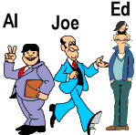
Look at Al, Joe and Ed, then make the comparison.
Joe is _________ than Ed. (short)
Al is the _________ (short)
Ed is the _________. (thin)
Joe is _________ than Al. (thin)
Al has the _________ clothes. (colourful)
Al is _________ than Joe. (heavy)
Ed is the _________. (light)
Joe is _________ than Ed. (happy)
Ed is the _________. (mysterious)
Joe is _________ than Ed. (energetic)

Slide 17
Fill in the correct form of the words in brackets (comparative or superlative).
My house is (big) __________ than yours.
This flower is (beautiful) __________ than that one.
The weather this summer is even (bad) __________ than last summer.
This is the (interesting) __________ book I have ever read.
It is strange but often a coke is (expensive) __________ than a beer.
Non-smokers usually live (long) __________ than smokers.
Which is the (dangerous) __________ animal in the world?
A holiday by the sea is (good) __________ than a holiday in the mountains.
Who is the (rich) __________ woman on earth?
He was the (clever) __________ thief of all.

Slide 18
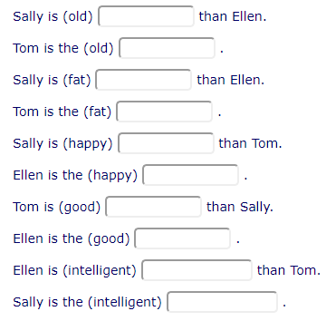

Slide 19
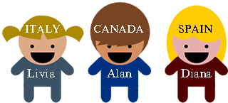
Exercises
1. Alan is _______________ (tall) than Livia.
2. Diana is _______________ (old) than Alan.
3. Livia is _______________ (short) than Diana.
4. Alan is _______________ (heavy) than Livia.
5. Livia is _______________ (young) than Diana.
6. Livia is _______________ (intelligent) than Alan.
7. Diana is _______________ (beautiful) than Livia.
8. Spain is _______________ (hot) than Canada.
9. Russia is _______________ (big) than Italy.
10. Italian is _______________ (easy) than Greek.

Slide 20
Exercises
1. Dogs are _______________ (intelligent) than rabbits.
2. Lucy is _______________ (old) than Ellie.
3. Russia is far _______________ (large) than the UK.
4. My Latin class is _______________ (boring) than my English class.
5. In the UK, the streets are generally _______________ (narrow) than
the streets in the USA.
6. London is _______________ (busy) than Glasgow.
7. Julie is _______________ (quiet) than her sister.
8. Amanda is _______________ (ambitious) than her classmates.
9. My garden is a lot _______________ (colourful) than this park.
10. His house is a bit _______________ (comfortable) than a hotel.

